Slide 1
GDP Data
File created on: 07.02.2021 16:26:41

Slide 2
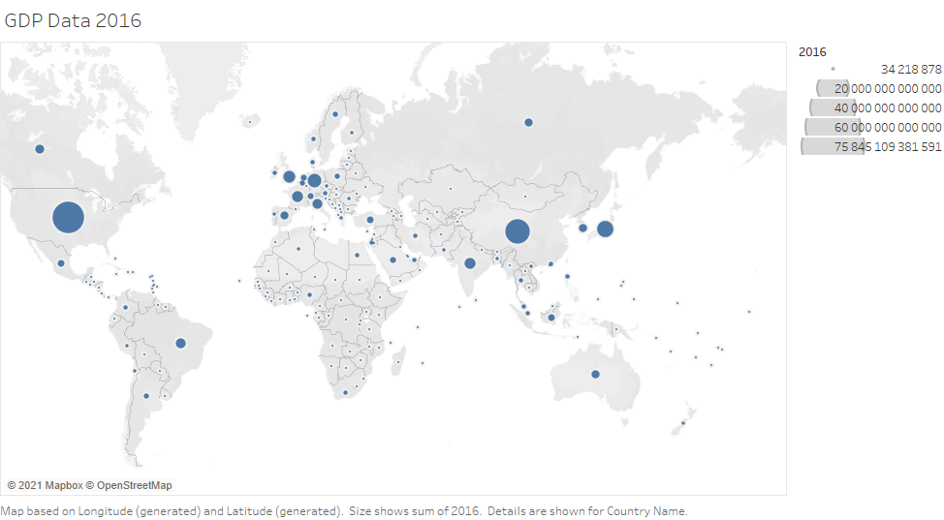

Slide 3
